Slide 1
Forest Protection Fungi II
Jakub Horák

Slide 2
Forest Protection
Biotics

Slide 3
Forest Protection
Biotic factors:
Insect
Game stocks
Weeds
Fungi
…

Slide 4
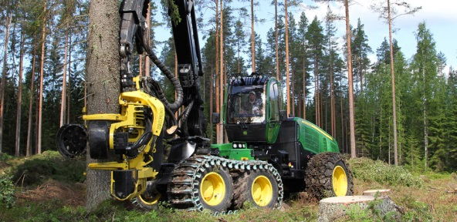
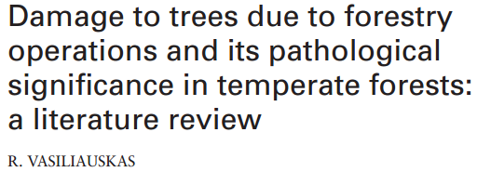
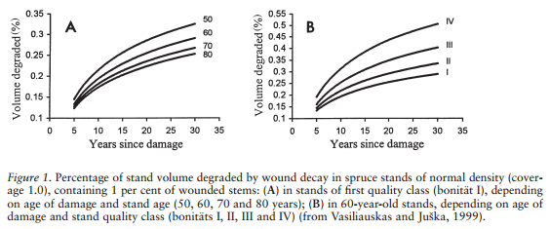
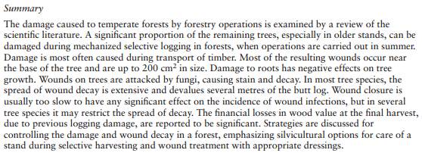
Forest Protection Forestry operations
blog.machinefinder.com

Slide 5
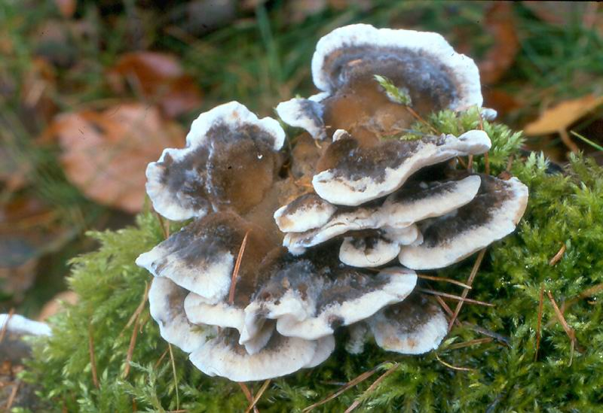
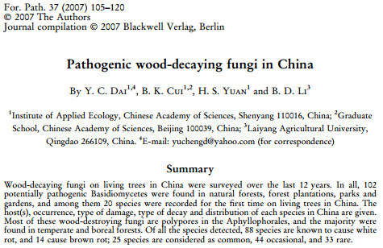
Forest Protection Fungal pathogens
www.biolib.cz
Although some wood-decaying fungi are weak parasites, they may potentially cause emerging diseases when transferred to other areas

Slide 6
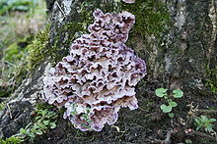
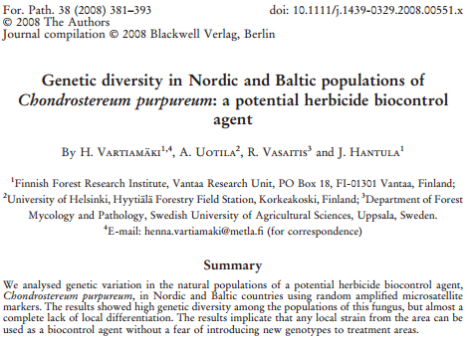
Forest Protection Fungi as bio-pesticides
http://en.wikipedia.org/

Slide 7
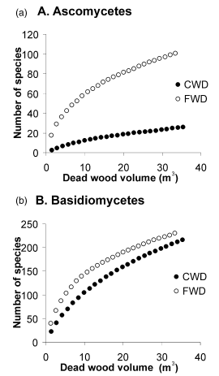
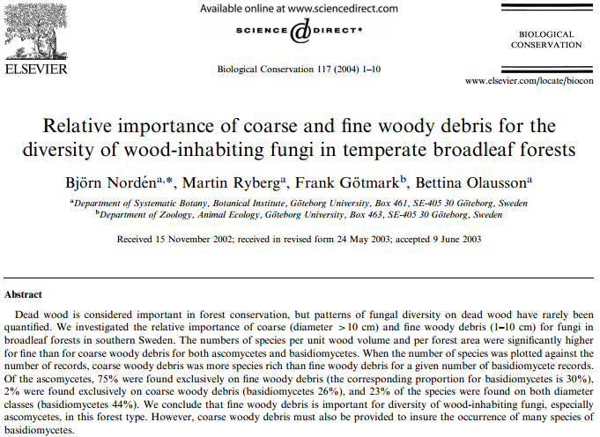
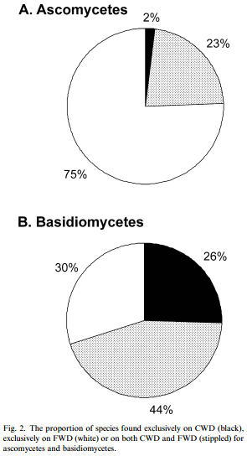
Forest Protection Fungi and dead wood

Slide 8
Forest Protection Conclusions
Forest protection against wood-decaying fungi appears to be relatively difficult.
As the main symptoms are almost conks that are the last product during the life of fungi.
Thus, we are most able to see damage after the wood was degraded.
The main assumption in forest protection against bracket fungi is prevention (e.g. during harvest)

Slide 9
Thank you for your attention

